Slide 1

Prediction of Bank Term Subscription Plan
By using Machine Learning/Artificial Intelligence Concepts

Slide 2

Prediction of Bank Term Subscription Plan
By using Machine Learning/Artificial Intelligence Concepts

Slide 3

Index
Introduction
Dataset Explained
Data Cleansing
Feature Engineering
Model Training and Testing Data
Analyzing the performance of each model
Feature Importance
Neural Networks?
Why not in this case?

Slide 4
Introduction
Introduction of Machine Learning for Predicting whether a customer will buy a Term Subscription or not in the current campaign running for its marketing.
The project involves development of Machine Learning Algorithms for predicting the potential customers.
This will allow better and dynamic planning for marketing of Term Subscription for the bank.

Slide 5
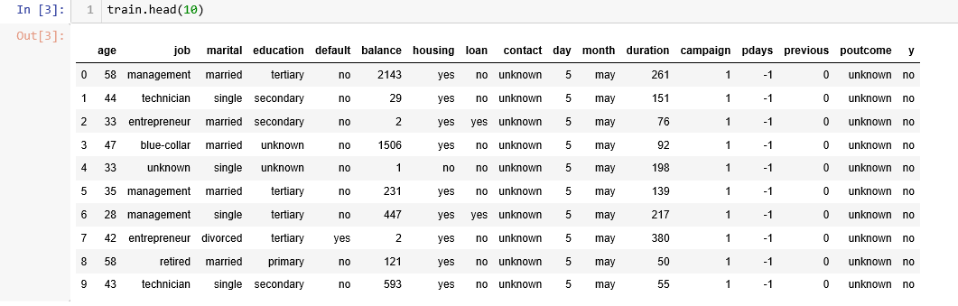
Dataset Explained
We have a dataset of 45211 labelled records. Shown above are first 10 records.

Slide 6

Features
Age → Age in years
Job → Type of job
marital → Marital status
education → Education background
default → Has credit in default?
balance → Balance of the individual
housing → Has housing loan?
loan → Has personal loan?
contact → Contact communication type
day → Last contact day of the week
month → Last contact month of year
duration → Last contact duration, in seconds
campaign → Number of contacts performed during this campaign and for this client
pdays → No. of days that passed by after the client was contacted from a previous campaign
previous → Number of contacts performed before this campaign and for this client
poutcome → Outcome of the previous marketing campaign

Slide 7

Data Cleansing
It is the act of detecting or correcting(or removing) corrupt or inaccurate records from a Dataset. Used mainly in Databases, the term refers to identifying incomplete, incorrect, inaccurate, irrelevant etc. parts of the data and then replacing, modifying or deleting this dirty data.
The more clean and processed the data is, the better result we get.

Slide 8
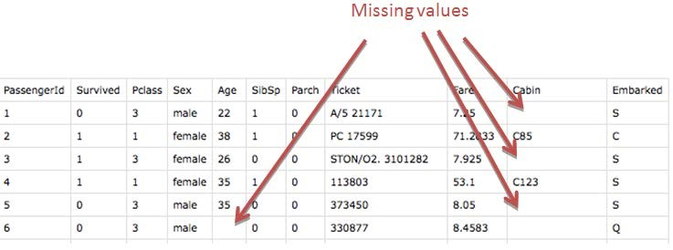
Steps taken to address Data Cleansing:
Treating Null Values : First and the foremost step is to look whether we have any missing values in our data or not. If the it is present, we take certain steps to deal with it.
Outlier Detection : Outlier are extreme values that deviate from other observations on data. There are different ways to deal with them. Here in our project, I tried to remove the possible outliers to make the model generic as much as possible.

Slide 9


Features Engineering
We can define it as pre-processing of raw data, on which machine can feed upon.
As we know machines only understand numbers. So, we have to convert the Data into a from which machine understands.
It is the most important step, while creating a model on Machine Learning.
As, the more clean or pre-processed our data is, the more better model we get.

Slide 10


I have divided the process of Feature Engineering is divided into 2 main parts:
Feature Engineering
Categorical Pipeline
Numerical Pipeline
Let’s dive into the code, to have better understanding on these pipelies.

Slide 11
Model Training and Testing Data
For making the model more generic, I splitted the whole dataset into two parts. One for training and the other one for testing(validation) of our trained model.
Full Dataset
Training Data
(80%)
Model Training
Testing Data(20%)
Model Testing
So, I have trained different models(Logistic Regression, Decision Tree, Random Forest, Bagging) on these data sets and tested as well.

Slide 12
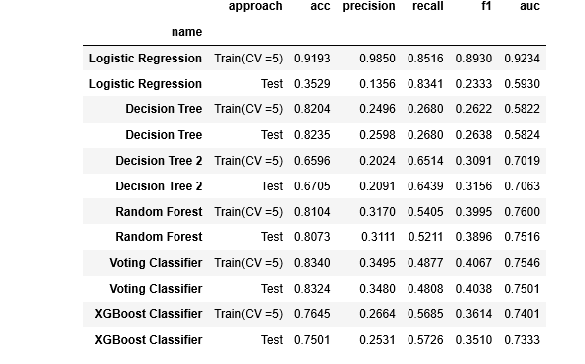
Analyzing the performance of each Model:

Slide 13
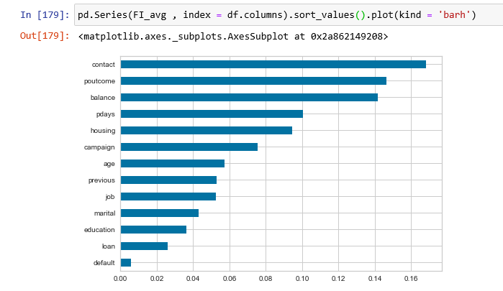
Feature Importance

Slide 14

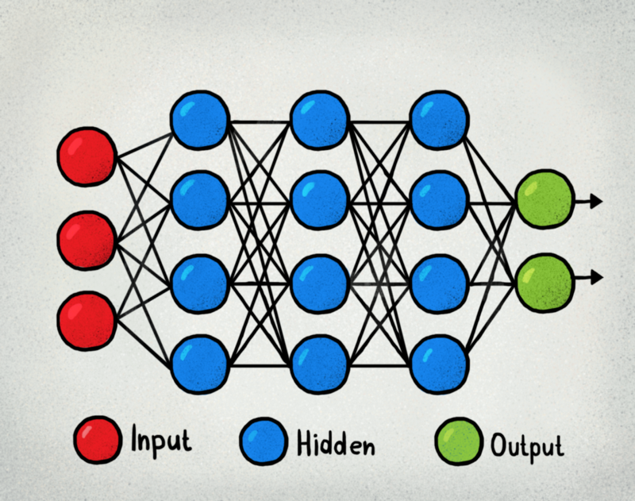
Neural Networks:

Slide 15
Why not in this case?
For Neural Networks to work, we need as much data as possible.
Less data leads to overtraining of the model.

Slide 16

Questions?

